Slide 1
New EWP Process
By: Aliaksandr Li
Dan Ofer
Henry Woodhouse
Kyle Yee
DPT-1623

Slide 2
The OG Development Cycle
Problems with reversions (reverts)
Complicated and stupidly complex
Too many branches
Too many Pull Requests

Slide 3
The New EWP Process
Name inspired by the New Super Mario Bros. games
No more reversions in the develop branch
Developers manually push to the QA environment
Simplified release process to UAT and PPE environments
Environmentally friendly!

Slide 4
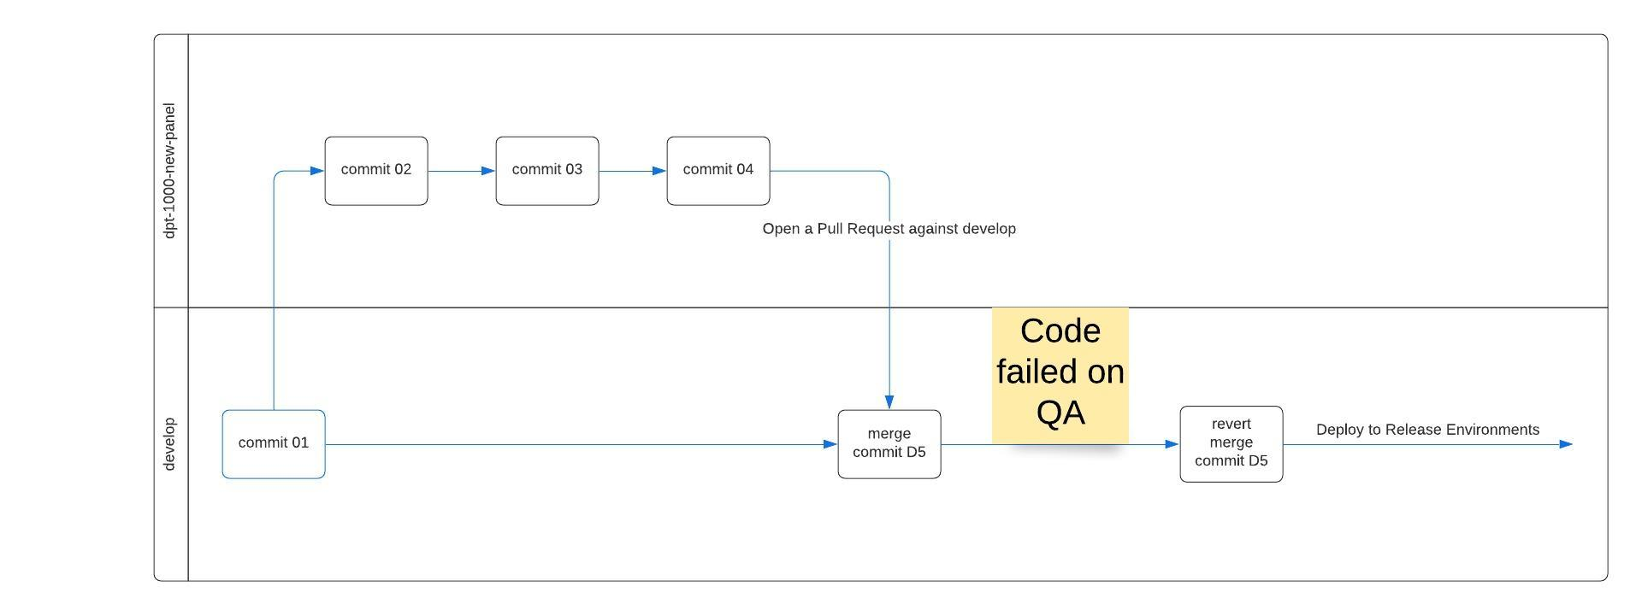
OG Development Process

Slide 5
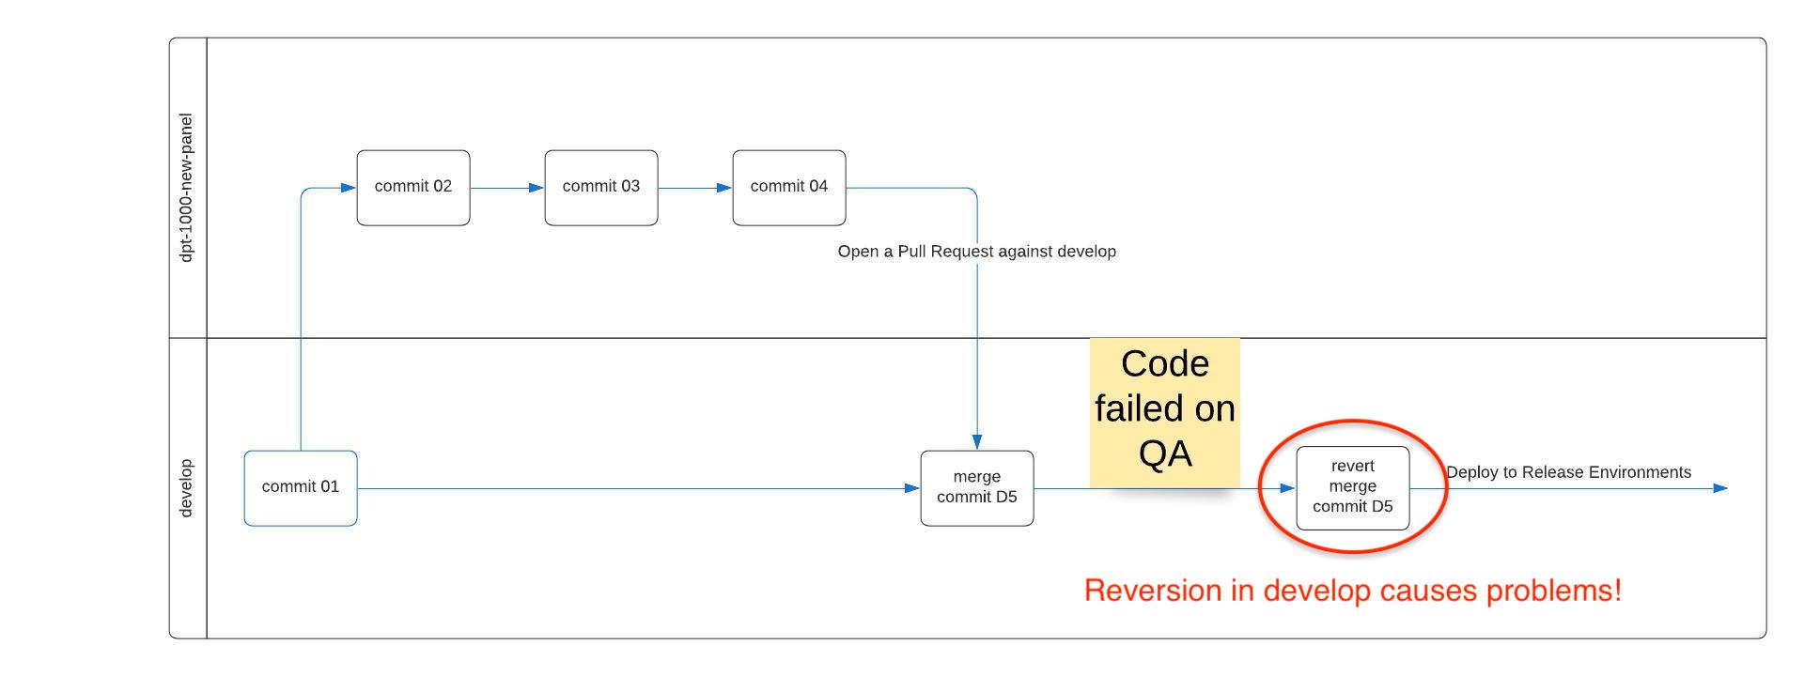
OG Development Process (with notes)

Slide 6
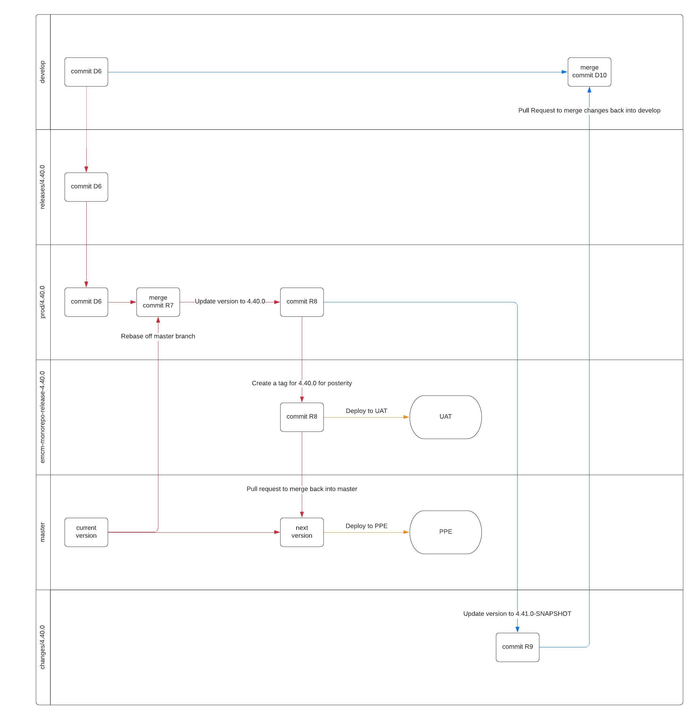
OG Release Process
Too complex!

Slide 7
Unnecessary branch!

Slide 8
Too many PRs

Slide 9
New simplified development process
Manually merge code into QA for testing
Only approved code is merged into develop

Slide 10
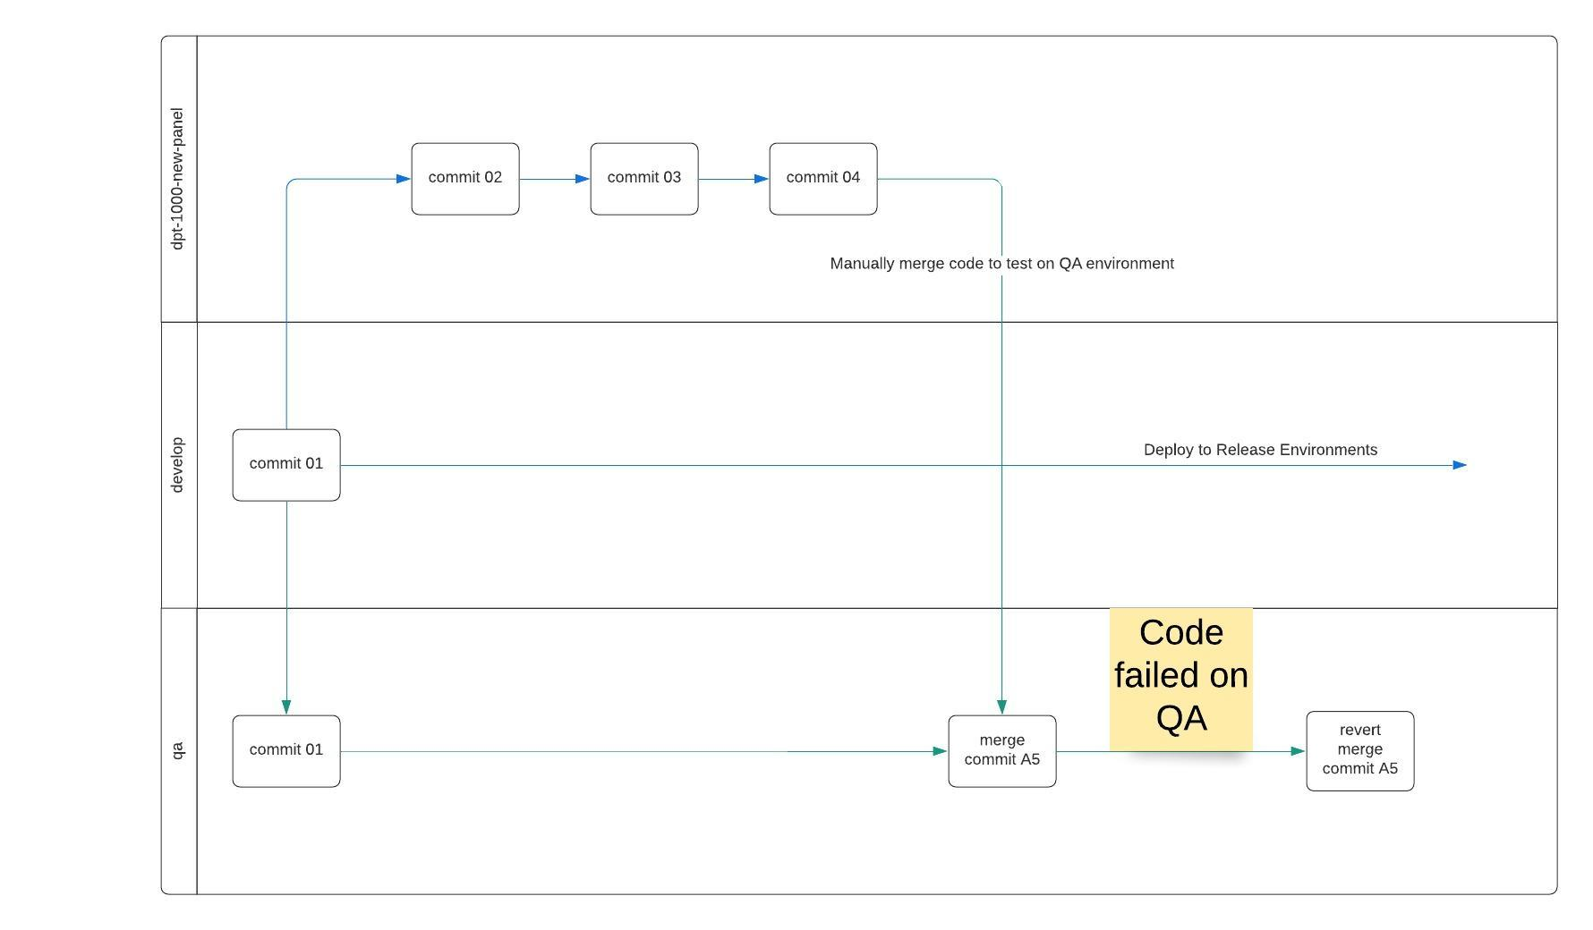
If QA failed
Do not merge failed code!

Slide 11
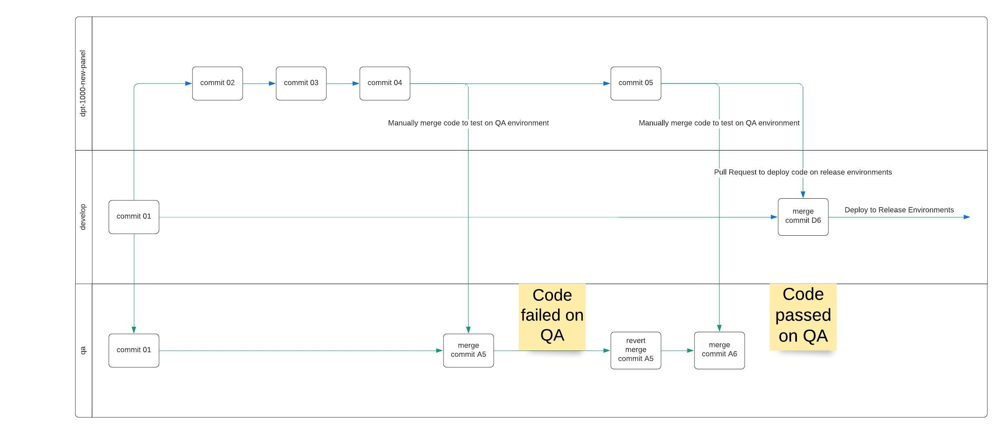
If QA passed
Merge the code!

Slide 12
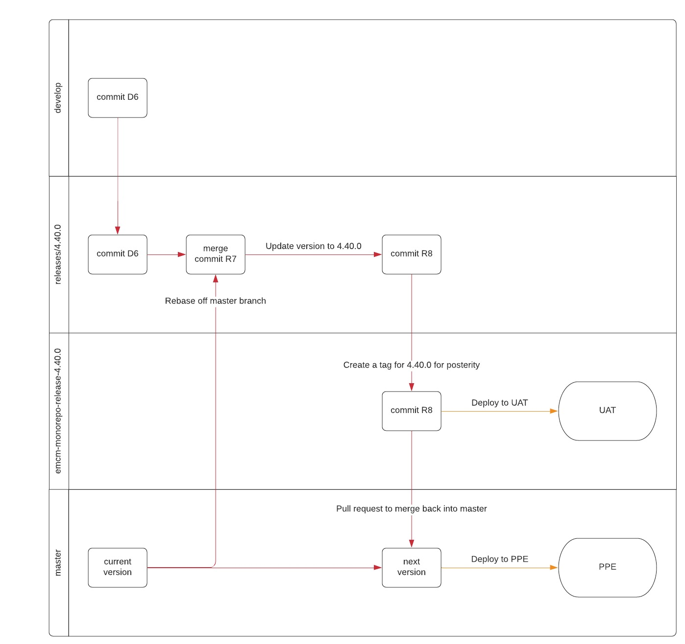
New simplified release process

Slide 13
Read more
https://confluence.thomsonreuters.com/display/DCE/Development+Process
https://confluence.thomsonreuters.com/display/DCE/Release+Process
https://confluence.thomsonreuters.com/display/DCE/Hotfix+Release+Process

